Slide 1
How Node Js is asynchronous, single threaded and event-driven at the same time?

Slide 2
agenda
Introduction
Basic Definition
Node js Architecture
Main topic explanation
Conclusion

Slide 3
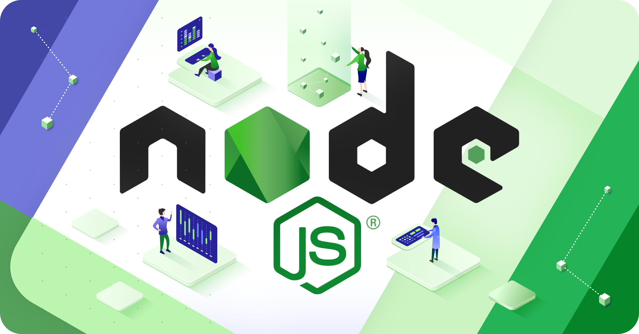
Introduction
Node.js is a free, open-source, cross-platform JavaScript runtime environment that lets developers create servers, web apps, command line tools and scripts.

Slide 4
Basic Definition
Lets see all the three terms one by one:
1)Asynchronous
2)Single Threaded
3)Event-Driven
Asynchronous :- Not simultaneous or concurrent in time.
Single Threaded :- This means that only one task can be executed at a time.
Event-Driven :- The control flow proceeds from response to an event.

Slide 5
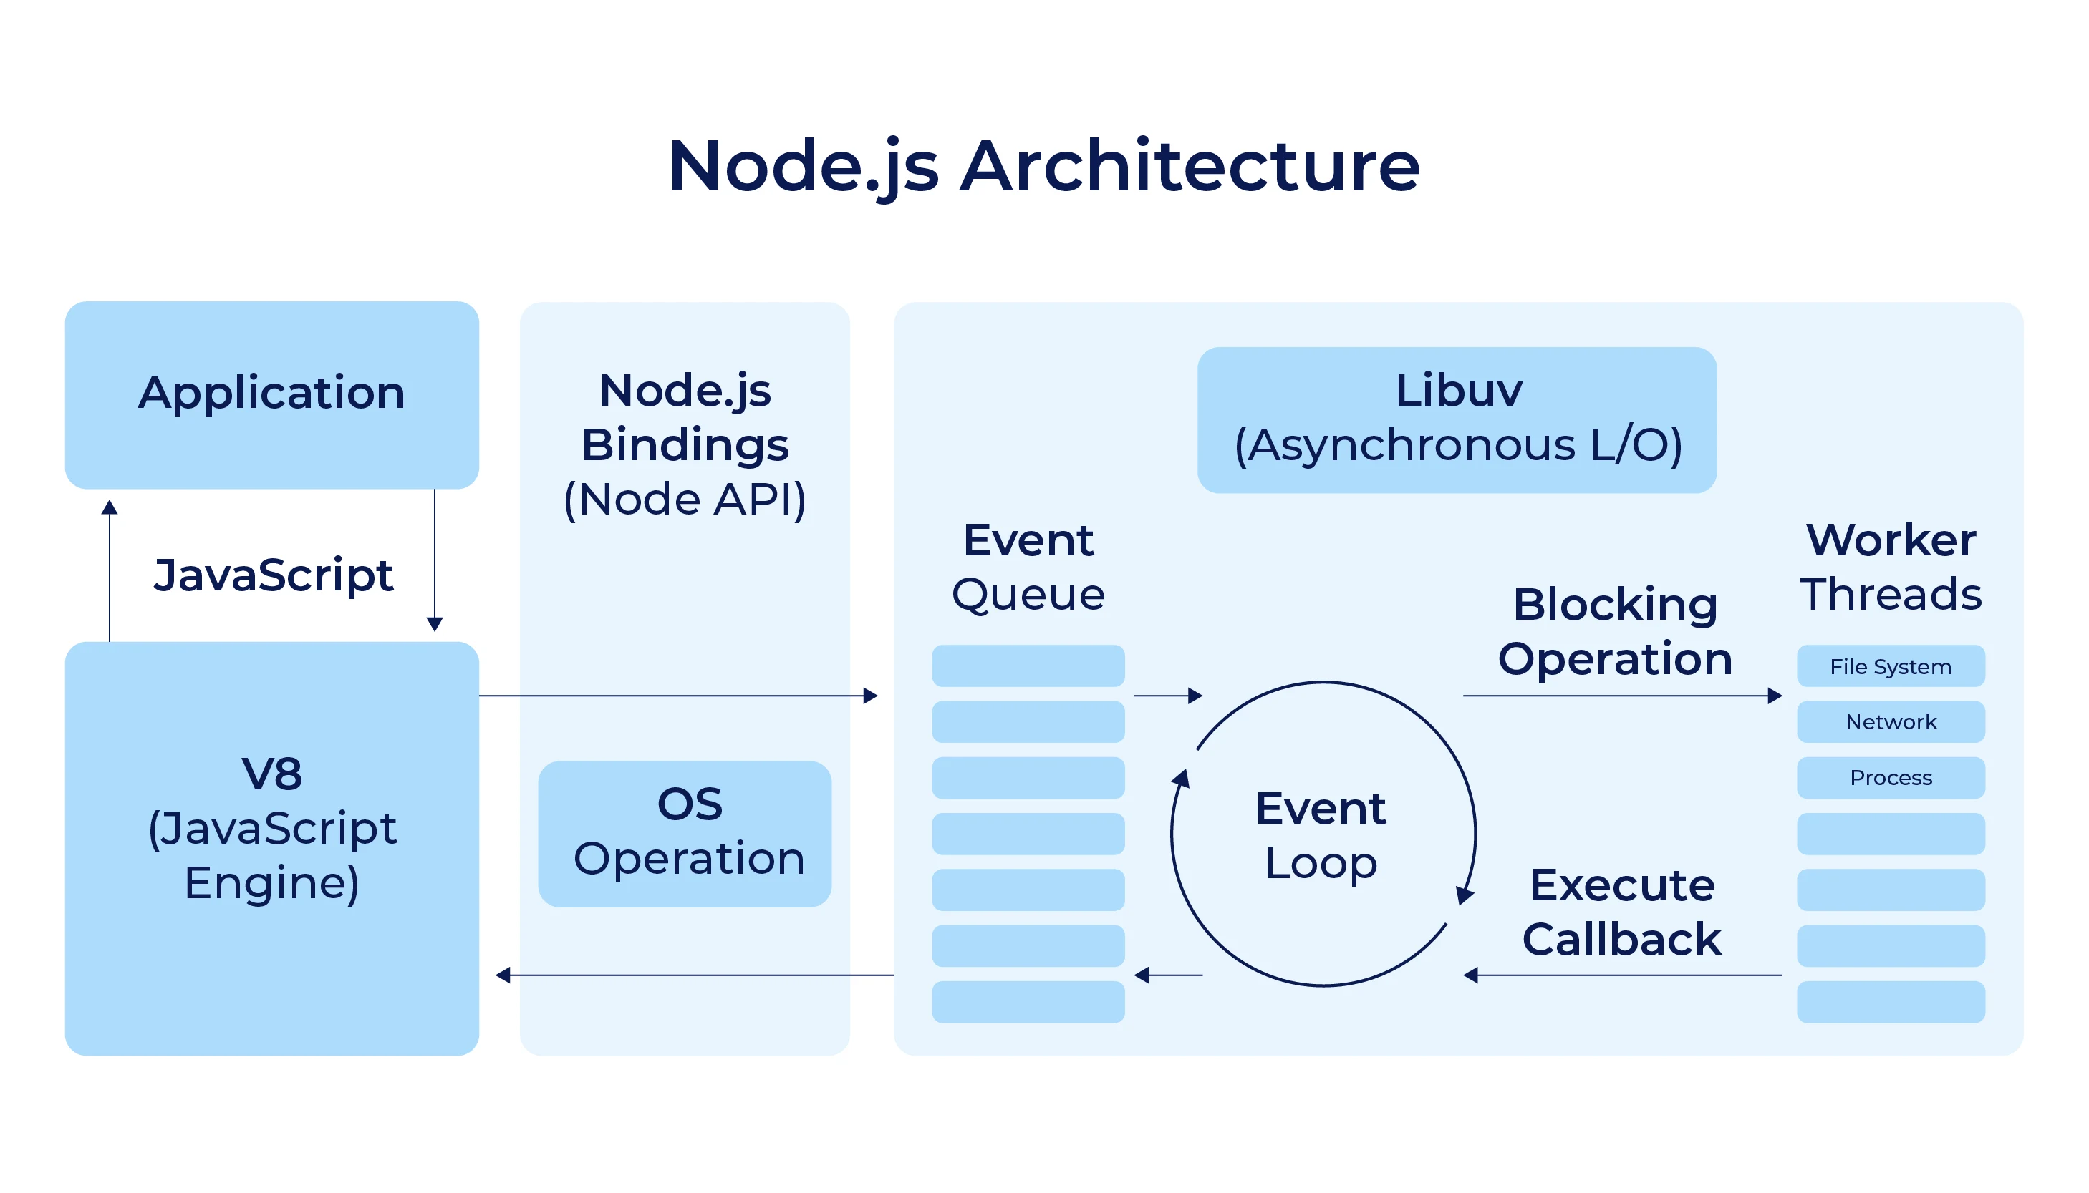
Node js architecture

Slide 6
Core concepts of the Architecture
Event Loop :- The event loop is the heart of Node.js, responsible for managing and executing asynchronous operations. Unlike traditional server-side environments that create a new thread for each client request, Node.js operates on a single-threaded event loop, which efficiently handles multiple client requests concurrently.
Modules and Packages :- Modules are building blocks of Node.js architecture and enable code organization and reuse. NPM is the world’s largest software registry. It provides access to over 1.5 million packages and simplifies the management of dependencies, versioning, and distribution of reusable code.
Callbacks:- Callbacks are functions passed as arguments to asynchronous operations, invoked when the operation completes. While straightforward, callback nesting (callback hell) can lead to complex and hard-to-read code.

Slide 7
4)Promises:- Promises offer a more elegant way to handle asynchronous operations by representing the eventual completion or failure of an asynchronous task. They provide methods like then(), catch(), and finally() to handle outcomes.
5)Node.js APIs:- Node.js provides a rich set of APIs to facilitate the development of server-side applications. These APIs cover various functionalities, from file system operations to networking.

Slide 8
Software architecture is defined as the software infrastructure within which application components providing user functionality can be specified, deployed, and executed. What kind of architecture does Node.js support? Node.js leverages the “Single Threaded Event Loop” architecture to take care of multiple concurrent clients. The event loop allows Node.js to perform non-blocking I/O operations by offloading operations to the system kernel. Kernels are multi-threaded which means they can handle multiple operations executing in the background.
When one of the operations completes, the kernel tells Node.js so that the appropriate callback may be added to the poll queue to be executed. When Node.js starts, it initializes the event loop, processes the provided input script, then begins processing the event loop. Each phase has a FIFO queue of callbacks to execute. When the queue has been exhausted or the callback limit is reached, the event loop will move to the next phase, and so on.

Slide 9
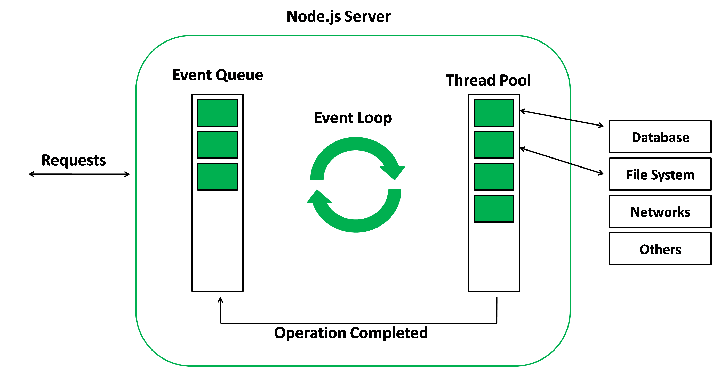
Main topic Explanation
Now, lets see the main topic of the presentation that is how the three terms (Asynchronous, Single Threaded and Event-Driven) are executed together in NodeJs.
All the Non-Blocking Operations are executed by the V8 Engine of Js but the problem comes with the Blocking Operations so we need a event queue and a event loop for that in this as the NodeJs is single threaded it gives a callback function to the main thread and it will not wait for the I/O operations or the blocking operation to occur. So like this it maintain the single threaded nature of js while keeping the data asynchronizing. Also Node.js known for its asynchronous nature complements EDA seamlessly. EDA leverages this by enabling non-blocking event handling. As events occur, Node.js efficiently manages these events concurrently without waiting for each operation to complete. This approach significantly enhances application performance, as the system can handle multiple tasks simultaneously without getting blocked by I/O operations or other tasks.

Slide 10
Conclusion
This is all about the architecture of NodeJs and how it can execute asynchronous, single thread and event-driven.
Thank you!!!
Submitted by:- Vaishnavi
Submitted to:- Kulanshu sir

